Slide 1
Apache Mahout
A project of Apache Software Foundation to produce free implementations of distributed or scalable machine learning algorithms
Binu P K
Asst. Professor
Dept. of Computer Science
School of Engineering
Amrita Vishwa Vidyapeetham, Amritapuri Campus

Slide 2
Introduction
Mahout is an open source project of Apache Software Foundation that is primarily used in producing scalable machine learning algorithms.
It started as a sub-project of Apache’s Lucene in 2008 and it tops all Apache projects now.
A mahout is one who drives an elephant as its master and the name comes from its close association with Apache Hadoop.
Hadoop is an open-source framework from Apache that allows to store and process big data in a distributed environment.
Mahout implements popular machine learning techniques such as:
Recommendation
Classification
Clustering

Slide 3
Features of Mahout
The algorithms of Mahout are written on top of Hadoop, so it works well in distributed environment.
It uses the Apache Hadoop library to scale effectively in the cloud.
It provides a ready-to-use framework for doing data mining tasks on large volumes of data.
It helps applications to analyze large sets of data effectively and quickly.
Includes several MapReduce enabled clustering implementations such as k-means, fuzzy k-means, Canopy, Dirichlet, and Mean-Shift.
Supports Distributed Naive Bayes and Complementary Naive Bayes classification implementations.
Includes matrix and vector libraries.

Slide 4

Use Cases of Mahout

Slide 5
Applications of Mahout
Top companies such as Adobe, Facebook, LinkedIn, Foursquare, Twitter, Yahoo etc. use Mahout internally.
Foursquare helps you in finding out places, food, and entertainment available in a particular area using the recommender engine of Mahout.
Twitter uses Mahout for user interest modelling.
Yahoo! uses Mahout for pattern mining.
AOL use Mahout for shopping recommendations.
DataMine Lab uses Mahout's recommendation and clustering algorithms to improve their clients' ad targeting.
Drupal uses Mahout to provide open source content recommendation solutions.
Evolv uses Mahout for its Workforce Predictive Analytics platform.

Slide 6
Mahout Machine Learning
Machine learning is a branch of science that deals with programming the systems in such a way that they automatically learn and improve with experience.
Mahout implements popular machine learning techniques such as recommendation, classification, and clustering.
Here, learning means recognizing and understanding the input data and making wise decisions based on it.
ML algorithms build knowledge from specific data and past experience with the principles of statistics, probability theory, logic, combinatorial optimization, search, reinforcement learning, and control theory.
ML algorithms form the basis of various applications such as Vision Processing, Language Processing, Forecasting, Pattern Recognition, Games, Data Mining, Expert Systems, Robotics etc.

Slide 7
Mahout Machine Learning
The most common ways to implement machine learning techniques are Supervised and Unsupervised learning.
Supervised learning deals with learning a function from available training data.
The algorithm analyzes the training data and produces an inferred function, which can be used for mapping new examples.
Some examples are classifying e-mails as spam, labeling webpages based on their content, voice recognition etc.
There are many supervised learning algorithms such as Neural Networks, Support Vector Machines (SVMs), and Naive Bayes classifiers.
Mahout implements Naive Bayes classifier.

Slide 8
Mahout Machine Learning
Unsupervised learning makes sense of unlabeled data without having any predefined dataset for its training.
It is an extremely powerful tool for analyzing available data and look for patterns and trends.
Most commonly used for clustering similar input into logical groups.
Common approaches to unsupervised learning include:
k-means
self-organizing maps, and
hierarchical clustering
k-means clustering is the central algorithm in unsupervised machine learning operation.
Mahout is focused on Recommendation, Classification and Clustering.

Slide 9
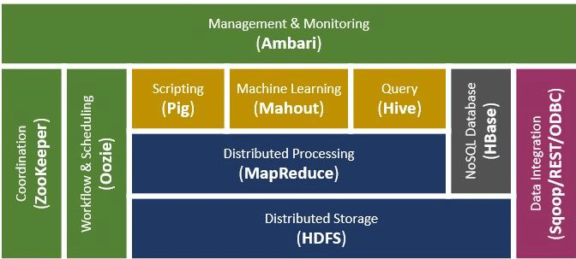
Apache Hadoop Ecosystem

Slide 10
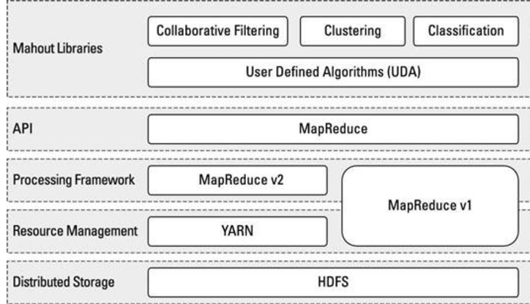
Mahout Architecture

Slide 11
Mahout Installation
Basic need for Apache Mahout is Hadoop and Java.
Single Node or Multi Node installation of Hadoop is needed first.
There are two ways you can download and install Apache Mahout (Direct download or Install via Maven)
Download tar gz file.
Extract it using command --------->> $ sudo tar -zxvf mahout-distribution-x.x.tar.gz.
Move unzip folder into /usr/lib directory ----->>> $ sudo mv mahout-distribution-x.x /usr/lib/mahout
Edit bashrc file ------>> "$ sudo gedit ~/.bashrc".
Add following line into it : export MAHOUT_HOME=/usr/local/mahout
Run this command ----->> "$ source ~/.bashrc".
Your Apache Mahout is installed successfully.

Slide 12
Mahout Installation
Install via Maven (Maven is a build automation tool used primarily for Java projects)
Install Maven ---->> $ sudo apt-get install maven.
Check it installed or not ---->> $ mvn -version.
Download {src ZIP} file of Mahout from the link http://ftp.wayne.edu/apache/mahout/
Unzip the Mahout File : $ unzip -a mahout-distribution-x.x-src.zip.
Move unzip folder into /usr/local directory ----->>> $ sudo mv mahout-distribution-x.x /usr/local/mahout
Go to mahout directory in terminal ---- >> cd /usr/local/mahout/.
Then Run following command ------->> "mvn install".
This will take around 30 minutes because it takes time to test all the algorithms.

Slide 13
Mahout Installation
Install via Maven
Edit the pom.xml file that resides in the base directory of the project and add the following lines.
<dependency>
<groupId>org.apache.mahout</groupId>
<artifactId>mahout-mr</artifactId>
<version>0.14.0</version>
</dependency>
POM stands for Project Object Model.
It is the fundamental unit of work in Maven which contains information about the project and various configuration detail used by Maven to build the project(s).
POM also contains the goals (tasks) and plugins.

Slide 14
Mahout Recommender Engine
Ever wondered how Amazon comes up with a list of recommended items to draw your attention to a particular product that you might be interested in??
Such recommendation lists are produced with the help of recommender engines.
Mahout provides recommender engines of several types such as:
user-based recommenders, item-based recommenders, and
several other algorithms.
Mahout has a non-distributed, non-Hadoop-based recommender engine.
You should pass a text document having user preferences for items.
The output of this engine would be the estimated preferences of a particular user for other items

Slide 15
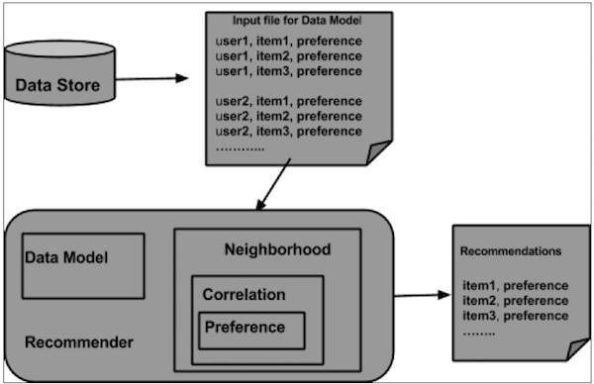
Architecture of Recommender Engine

Slide 16
Architecture of Recommender Engine
The components provided by Mahout to build a recommender engine are as follows:
DataModel
UserSimilarity
ItemSimilarity
UserNeighborhood
Recommender
Steps to create a Recommender using Mahout
Step1: Create DataModel Object
The constructor of PearsonCorrelationSimilarity class requires a data model object.
File must have the Users, Items, and Preferences details of a product.

Slide 17
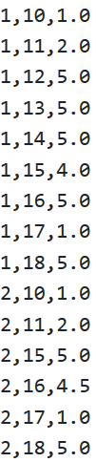

Architecture of Recommender Engine
Following is a sample data model file: “dataset.csv”
DataModel model = new FileDataModel(new File("/path/to/dataset.csv"));
The DataModel object requires the file object, which contains the path of the input file.

Slide 18
Architecture of Recommender Engine
Step2: Create UserSimilarity Object
In this example, we want to create a user-based recommender.
When we compute recommendations for a particular user, we look for other users with a similar taste and pick the recommendations from their items.
For finding similar users, we have to compare their interactions.
One popular method is to compute the correlation coefficient between their interactions.
In Mahout, you use this method as follows:
Create UserSimilarity object using PearsonCorrelationSimilarity class as shown below:
UserSimilarity similarity = new PearsonCorrelationSimilarity(datamodel);

Slide 19
Architecture of Recommender Engine
Step3: Create UserNeighborhood Object
The next thing we have to do is to define which similar users we want to leverage for the recommender.
There are two types of neighborhoods:
NearestNUserNeighborhood - This class computes a neighborhood consisting of the nearest n users to a given user. "Nearest" is defined by the given UserSimilarity.
ThresholdUserNeighborhood - This class computes a neighborhood consisting of all the users whose similarity to the given user meets or exceeds a certain threshold. Similarity is defined by the given UserSimilarity. For simplicity, here we use ThresholdUserNeighborhood
UserNeighborhood neighborhood = new ThresholdUserNeighborhood(2.0, similarity, model);

Slide 20
Architecture of Recommender Engine
Step4: Create Recommender Object
Now we have all the pieces to create our recommender.
Create UserbasedRecomender object and pass all the above created objects to its constructor as shown below.
UserBasedRecommender recommender = new GenericUserBasedRecommender(model, neighborhood, similarity);
Step5: Recommend Items to a User
Recommend products to a user using the recommend() method of Recommender interface.
This method requires two parameters. The first represents the user id of the user to whom we need to send the recommendations, and the second represents the number of recommendations to be sent.

Slide 21
Architecture of Recommender Engine
Here is the usage of recommender() method:
List<RecommendedItem> recommendations = recommender.recommend(2, 3);
for (RecommendedItem recommendation : recommendations)
{
System.out.println(recommendation);
}
Now you have built your first recommender using Apache Mahout!

Slide 22
Example Program
Given below is an example program to set recommendation for the user with user id 2.
import java.io.File; import java.util.List;
import org.apache.mahout.cf.taste.impl.model.file.FileDataModel;
import org.apache.mahout.cf.taste.impl.neighborhood.ThresholdUserNeighborhood; import org.apache.mahout.cf.taste.impl.recommender.GenericUserBasedRecommender; import org.apache.mahout.cf.taste.impl.similarity.PearsonCorrelationSimilarity;
import org.apache.mahout.cf.taste.model.DataModel;
import org.apache.mahout.cf.taste.neighborhood.UserNeighborhood;
import org.apache.mahout.cf.taste.recommender.RecommendedItem;
import org.apache.mahout.cf.taste.recommender.UserBasedRecommender;
import org.apache.mahout.cf.taste.similarity.UserSimilarity;

Slide 23
Example Program
public class Recommender {
public static void main(String args[]){
try{
//Creating data model
DataModel datamodel = new FileDataModel(new File("/path/to/dataset.csv "));
//Creating UserSimilarity object.
UserSimilarity usersimilarity = new PearsonCorrelationSimilarity(datamodel);
//Creating UserNeighbourHHood object.
UserNeighborhood userneighborhood = new ThresholdUserNeighborhood(3.0, usersimilarity, datamodel);
//Create UserRecomender
UserBasedRecommender recommender = new GenericUserBasedRecommender(datamodel, userneighborhood, usersimilarity); List<RecommendedItem> recommendations = recommender.recommend(2, 3);
for (RecommendedItem recommendation : recommendations) {
System.out.println(recommendation);
}
}catch(Exception e) { }
}
}

Slide 24
Example Program
Compile the program using the following commands:
javac Recommender.java
java Recommender
It should produce the following output:
RecommendedItem [item:3, value:4.5] RecommendedItem [item:4, value:4.0]

Slide 25
Thank You..
Mahout Clustering and Classification will be covered in next session

